Slide 1
Dropout

Slide 2
Dropout
Dropout

Slide 3
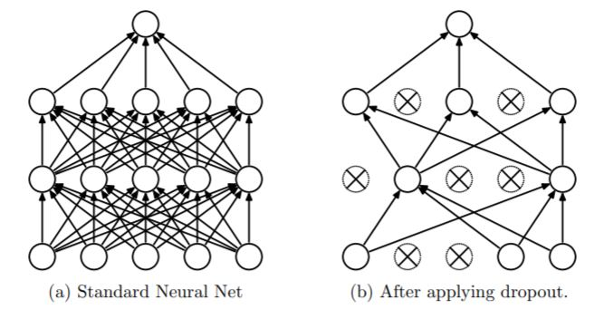
Dropout
Dropout: A Simple Way to Prevent Neural Networks from Overfitting

Slide 4
Dropout
Why Use Dropout?
Reduce Overfitting => Regularization
Dropout: A Simple Way to Prevent Neural Networks from Overfitting

Slide 5
Dropout
Dropout: A Simple Way to Prevent Neural Networks from Overfitting

Slide 6
Dropout
Dropout: A Simple Way to Prevent Neural Networks from Overfitting

Slide 7
Dropout
Dropout: A Simple Way to Prevent Neural Networks from Overfitting

Slide 8
감사합니다
THANK YOU

